Slide 1

Hardware-Aware Quantum Circuit Synthesis
An A* Search and Genetic Algorithm Compiler with Peephole Optimization
Thota Venkata Avinash Naidu
QUEST-AI 2026
01-09-2026

Slide 2
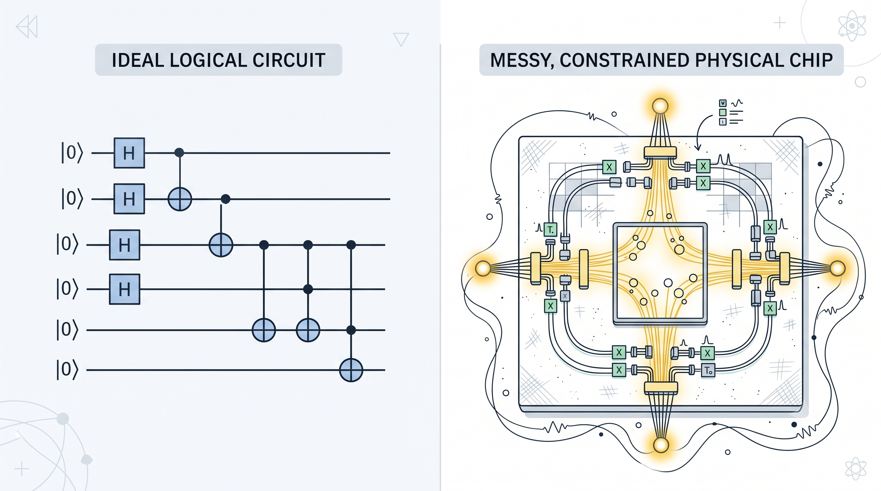

The Introduction and Hypothesis:
The Promise: Quantum algorithms offer exponential speedups over classical computing.
The Reality (NISQ Era): Physical hardware is severely limited by restricted instruction sets and sparse physical connectivity (coupling maps).
The Bottleneck: Standard compilation leaves redundant gates, which increases overall execution time and exposes the circuit to higher error rates.
Figure 1: Comparison between an ideal abstract logical circuit and constrained physical hardware topology.

Slide 3
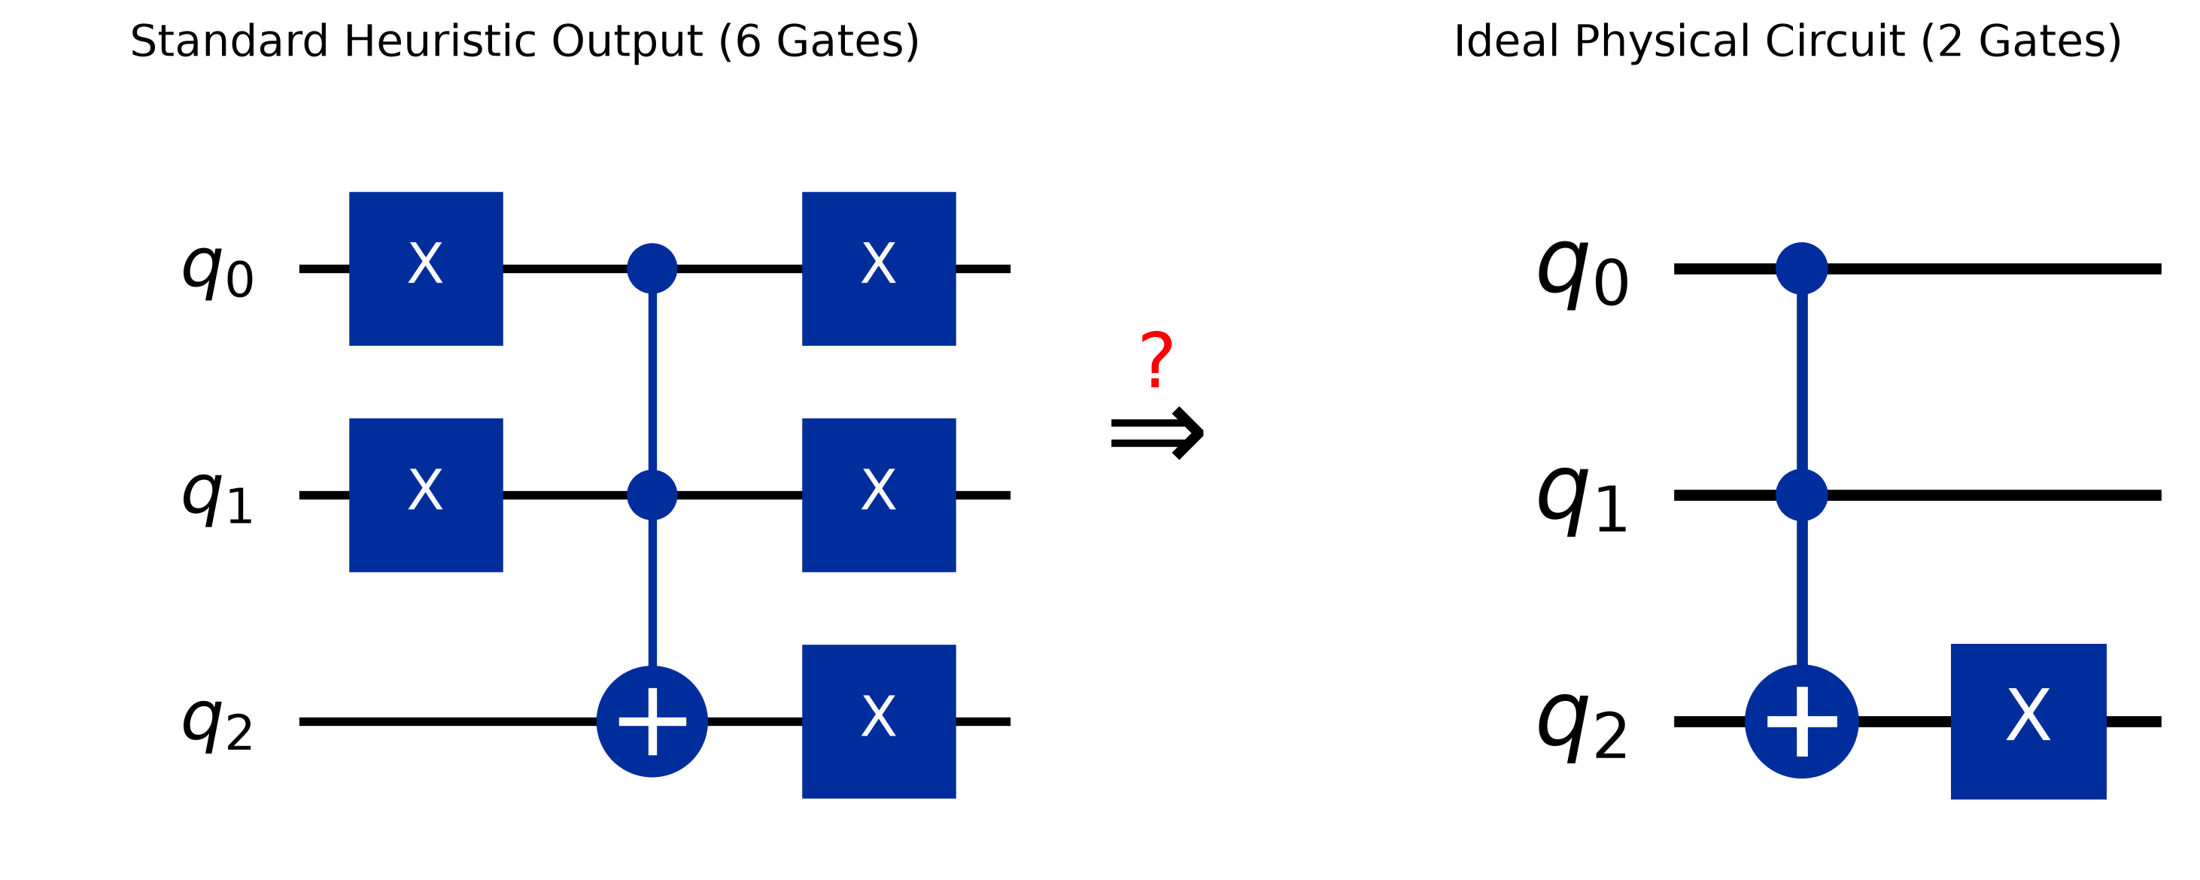
The Redundancy Bottleneck
Standard transpilers rely on heuristic rules that often miss deep logical inefficiencies.
Naive translations consistently leave behind redundant operations, like duplicated X gates.
These unnecessary gates increase execution time and introduce noise on constrained hardware.
Our compiler automatically bridges the gap between bloated outputs and minimal circuit depth.
Figure 2: The redundancy gap between a naive 6-gate translation (left) and the minimal 2-gate physical circuit (right).

Slide 4








Hypothesis: Quantum-Compiler Architecture
An end-to-end transpiler optimizing logical Boolean circuits into executable quantum circuits, mirroring classical compiler architecture.
1. Logical Input
2. Baseline Trans.
3. Global Search
4. Peephole Opt.
Front-end parses logic into a formal, symbol-table-free Intermediate Representation (IR).
Naive mapping of classical gates to reversible Toffoli primitives.
Exact A* search combined with Genetic Algorithms for optimal layouts.
Localized pattern matching to eliminate remaining logic redundancies.
Figure 3: The end-to-end multi-pass architecture of the proposed quantum transpiler.

Slide 5
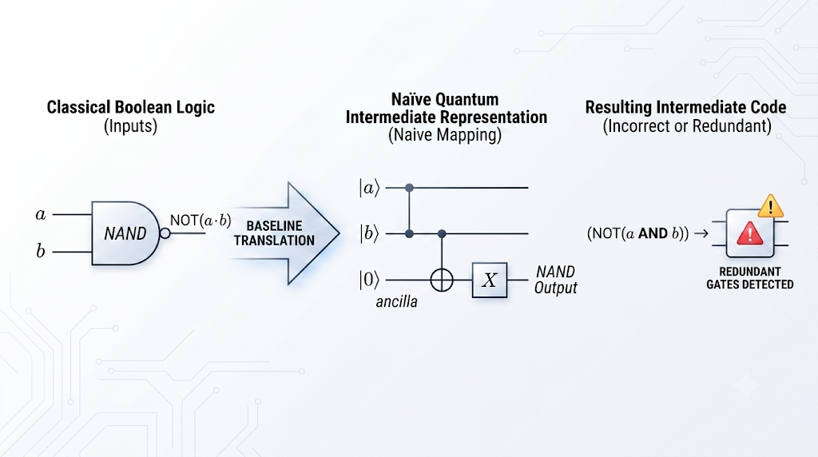

Materials and Methods:
Phase 1: Baseline Translation
The front end parses logic into a symbol-table-free Intermediate Representation (IR).
Naive translation occurs : mapping classical gates (like AND, OR) to reversible Toffoli primitives.
The Result: Circuits are logically correct but highly inefficient, burdened with redundant ancilla qubits.
Figure 4: Naïve baseline translation mapping classical Boolean logic to an unoptimized quantum intermediate representation.

Slide 6
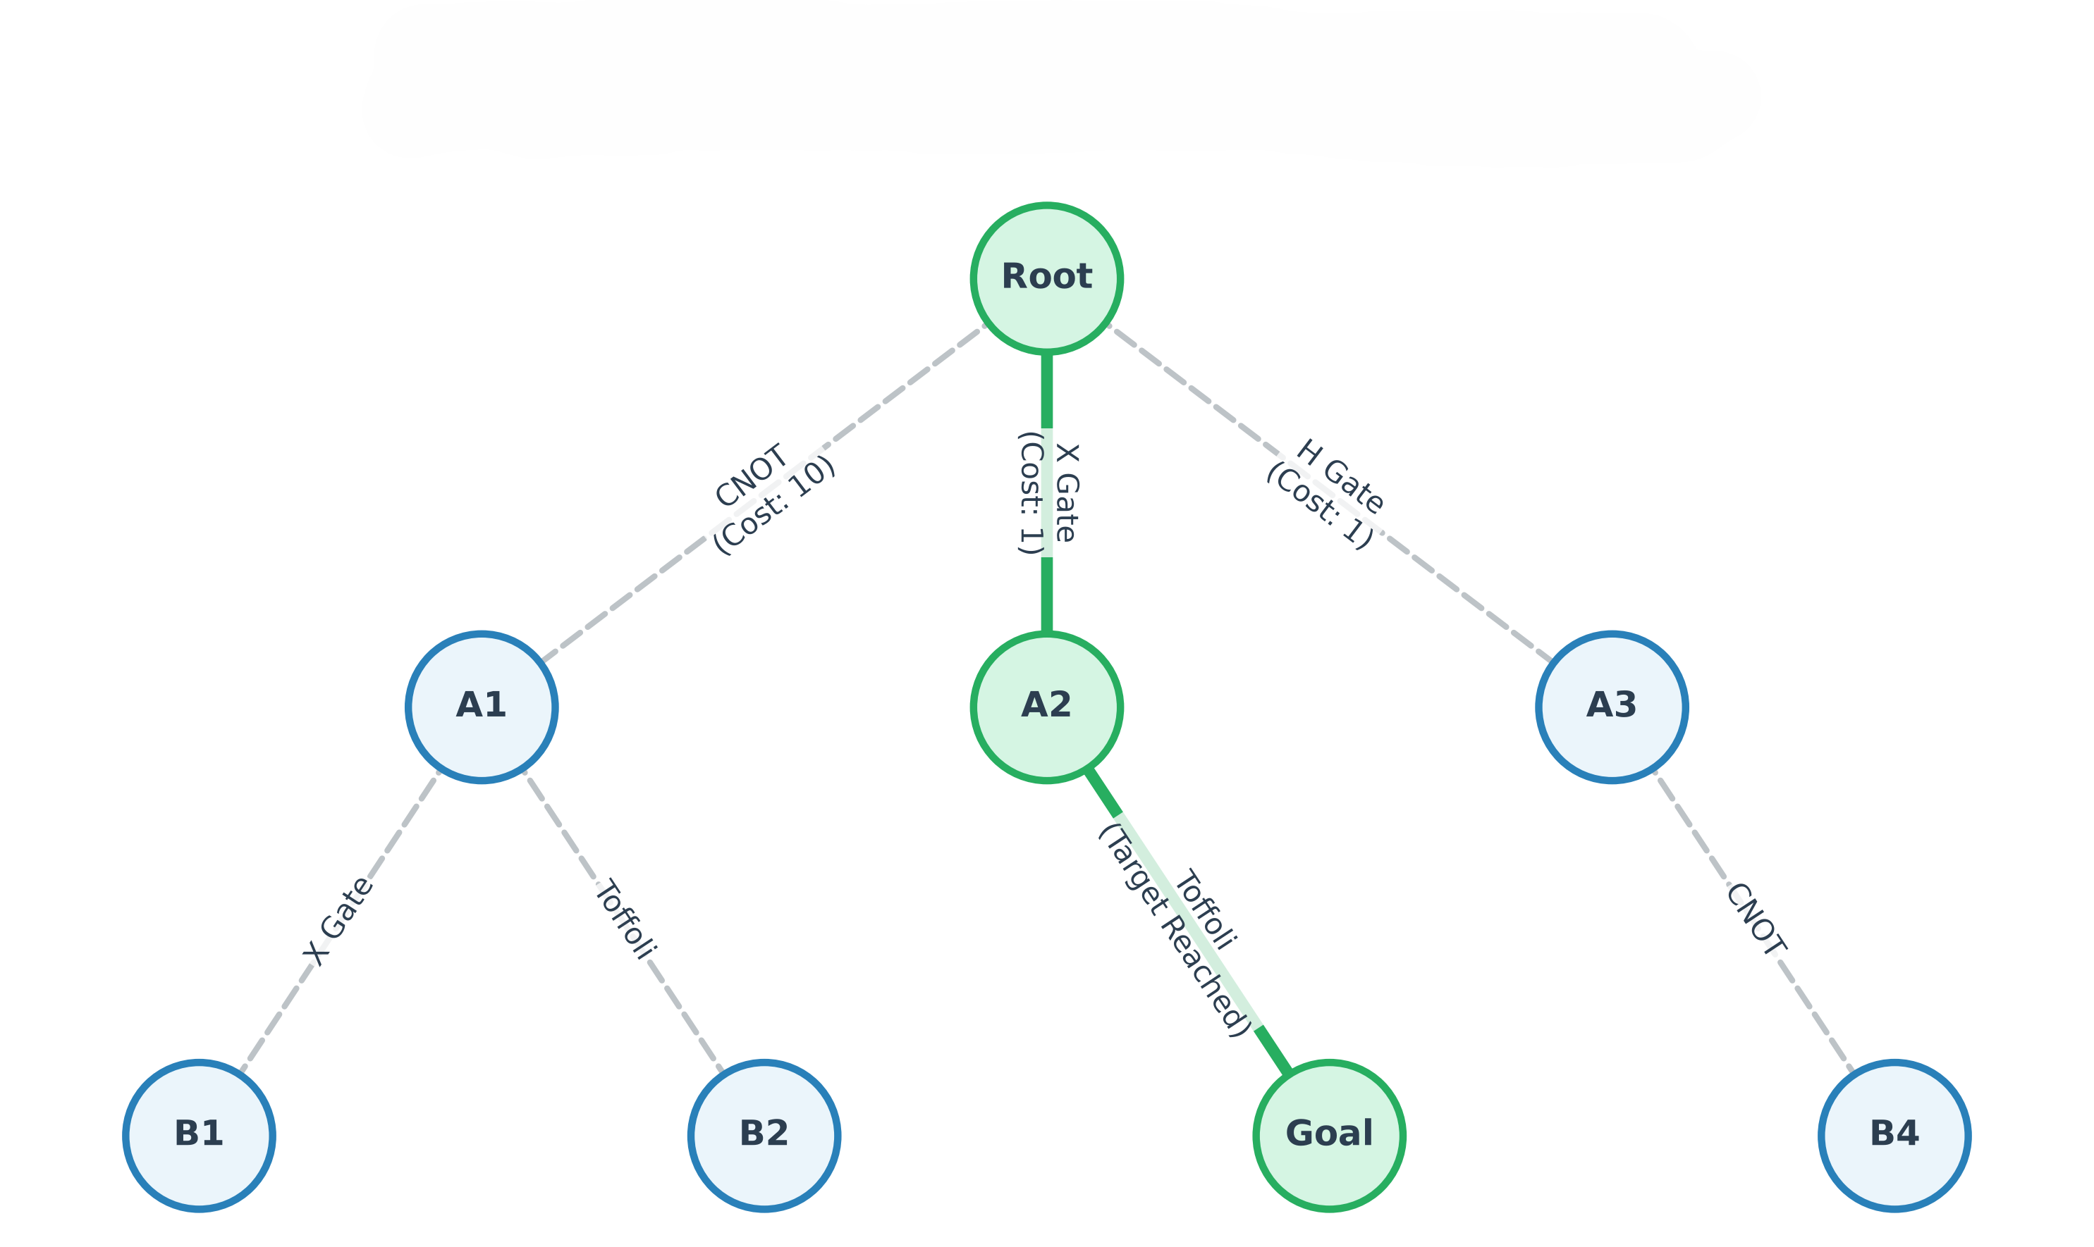
Phase 2: Optimization by A* Search
Treats circuit synthesis as a shortest-path routing problem over an immense state space.
Our hardware-aware cost model heavily penalizes expensive two-qubit hardware gates (e.g., CNOT).
Utilizes a zero or Hamming distance heuristic to mathematically guarantee a minimal circuit layout.
Figure 5: A* search tree utilizing a hardware-aware cost heuristic for exact circuit layout synthesis.

Slide 7

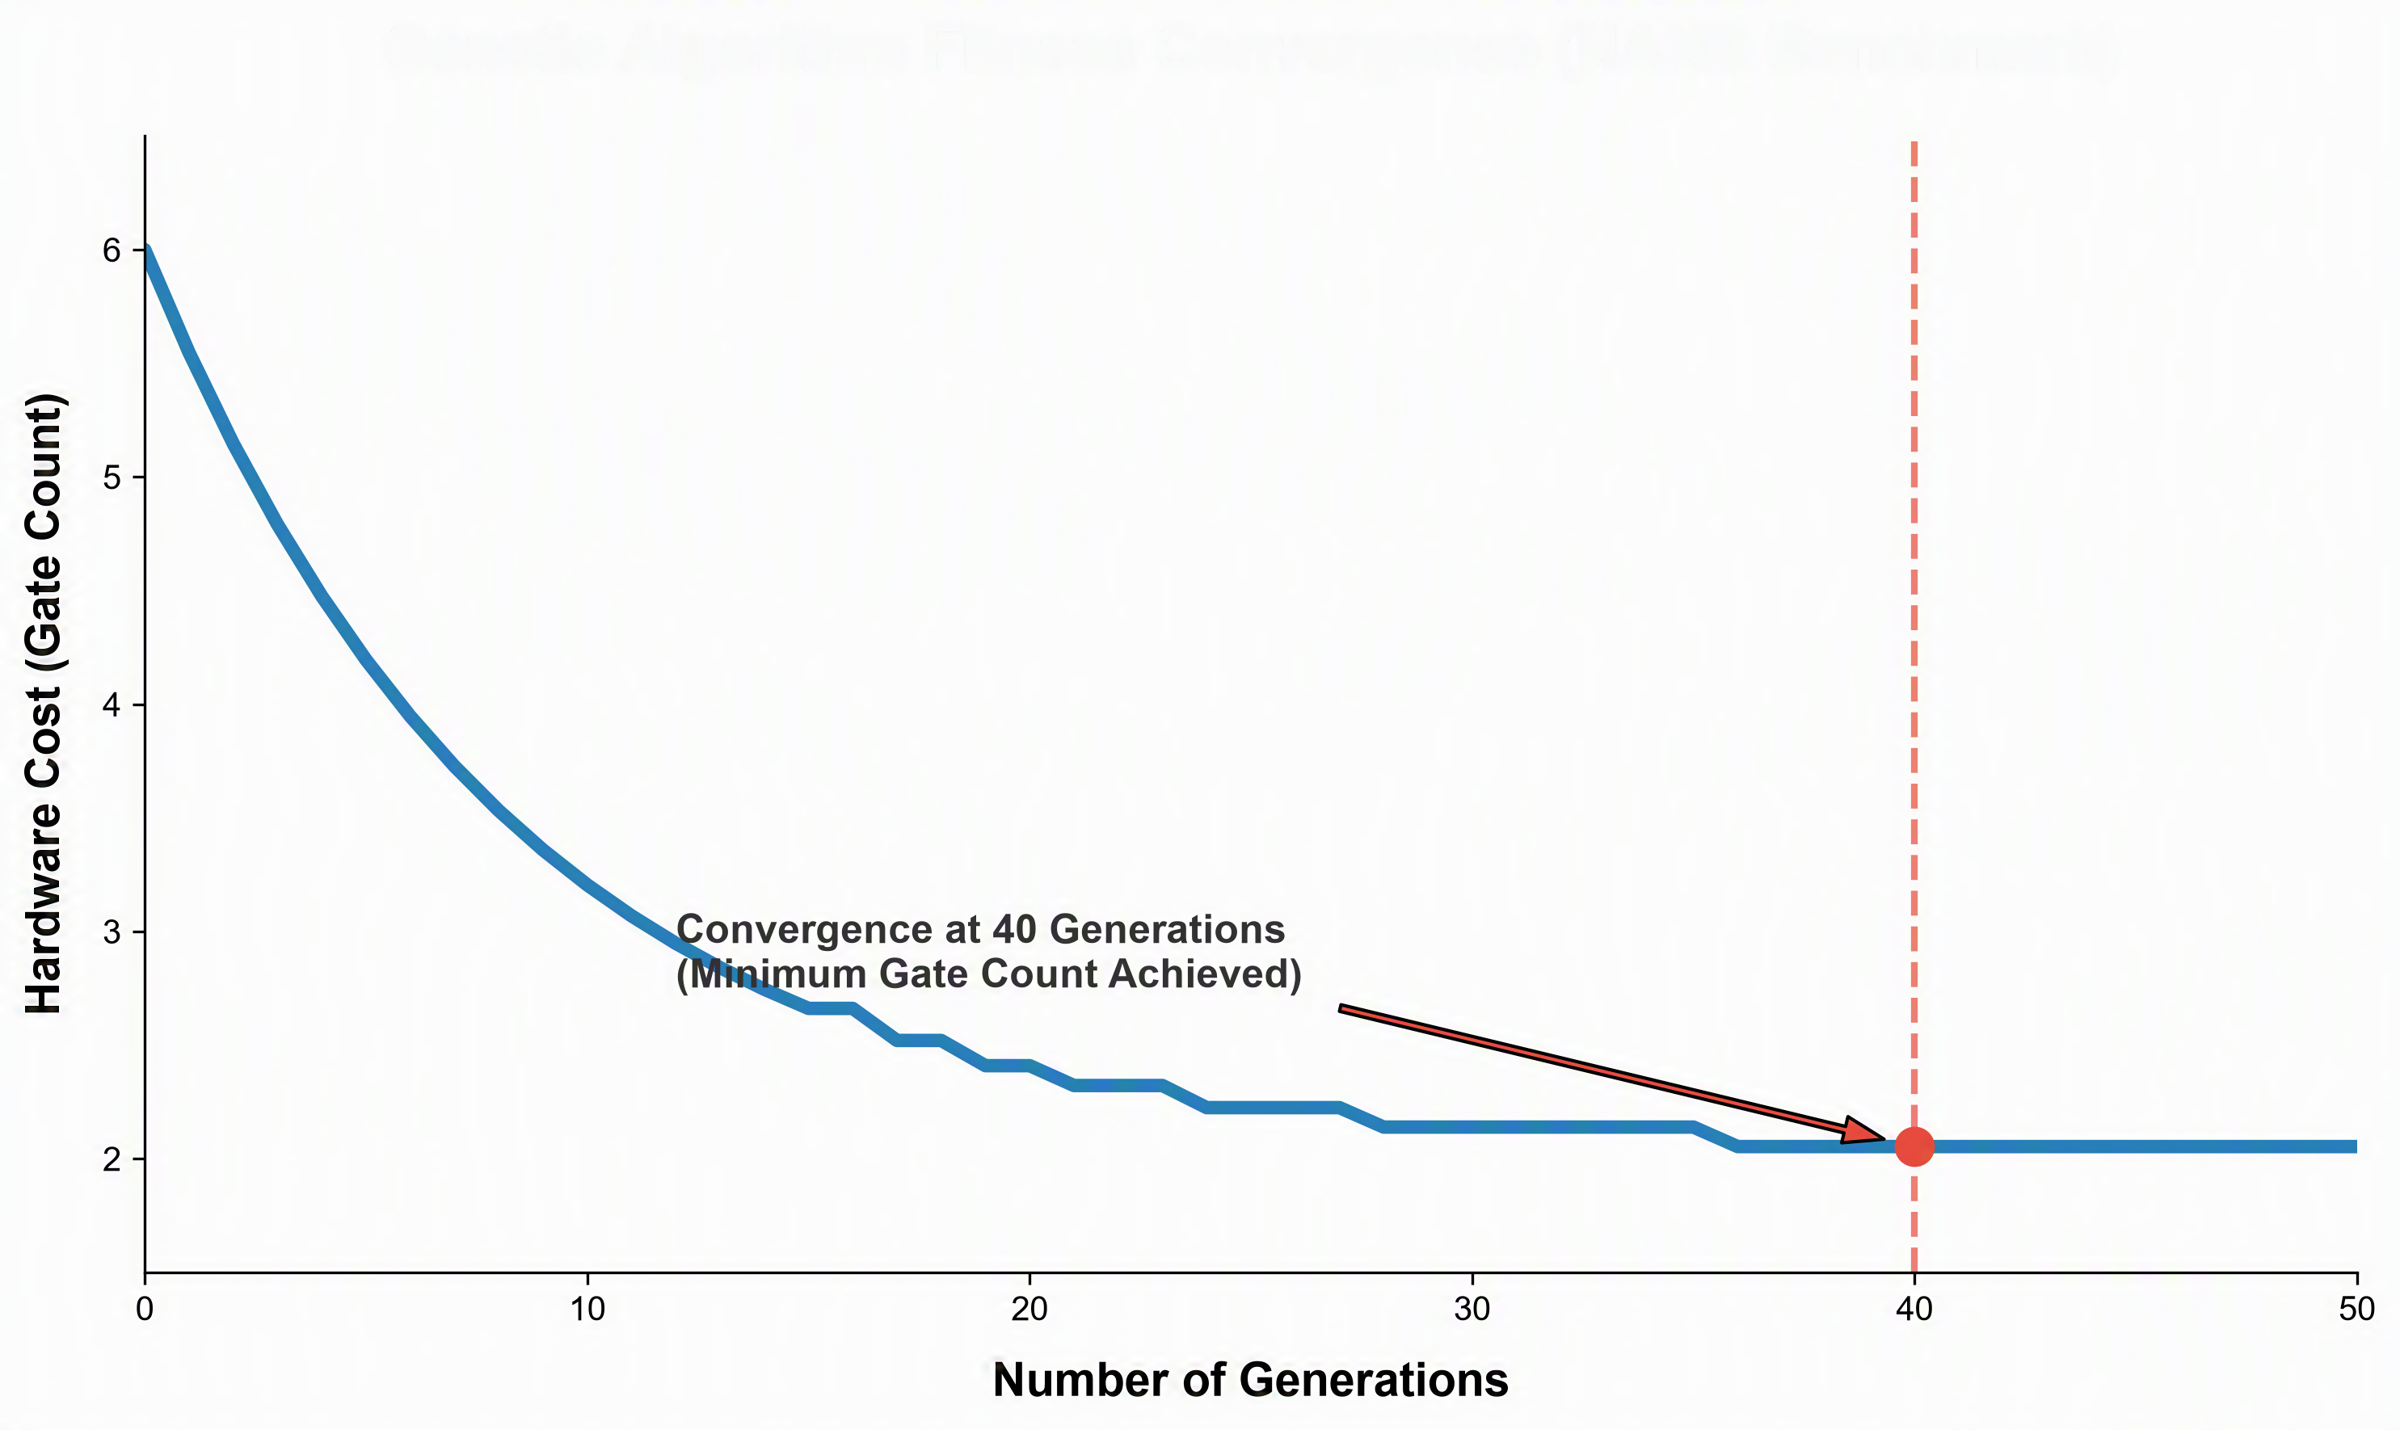
Phase 3: Genetic Algorithm Post-Optimization
Scaling Beyond Exact Limits
A* search hits hard limits due to state-space explosion on larger multi-qubit systems.
The GA explores massive search spaces, trading strict optimality guarantees for practical, scalable gains.
Evolves populations via Selection, Crossover, and Mutation.
Evaluates fitness robustly based on logic errors and overall hardware cost.
Figure 6: Fitness convergence graph demonstrating rapid minimization of hardware gate costs over 40 generations.

Slide 8
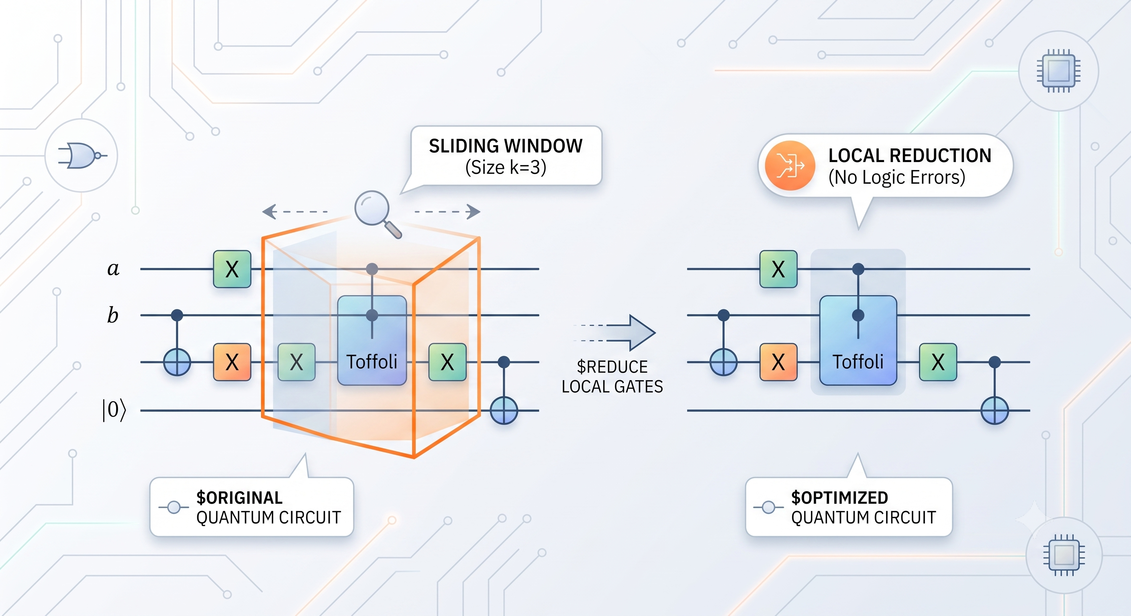
Phase 4: Peephole Optimization
The Core Contribution
Bridging the gap between global search and final hardware execution.
Scans sliding windows of 2–4 gates across the circuit.
Identifies and eliminates localized logical redundancies left behind by global searches.
Utilizes a Rewrite Library: Conservative, simulation-verified pattern matching ensures absolute functional correctness.
Figure 7: Peephole optimization pass applying a sliding window to eliminate localized redundant gate pairs.

Slide 9
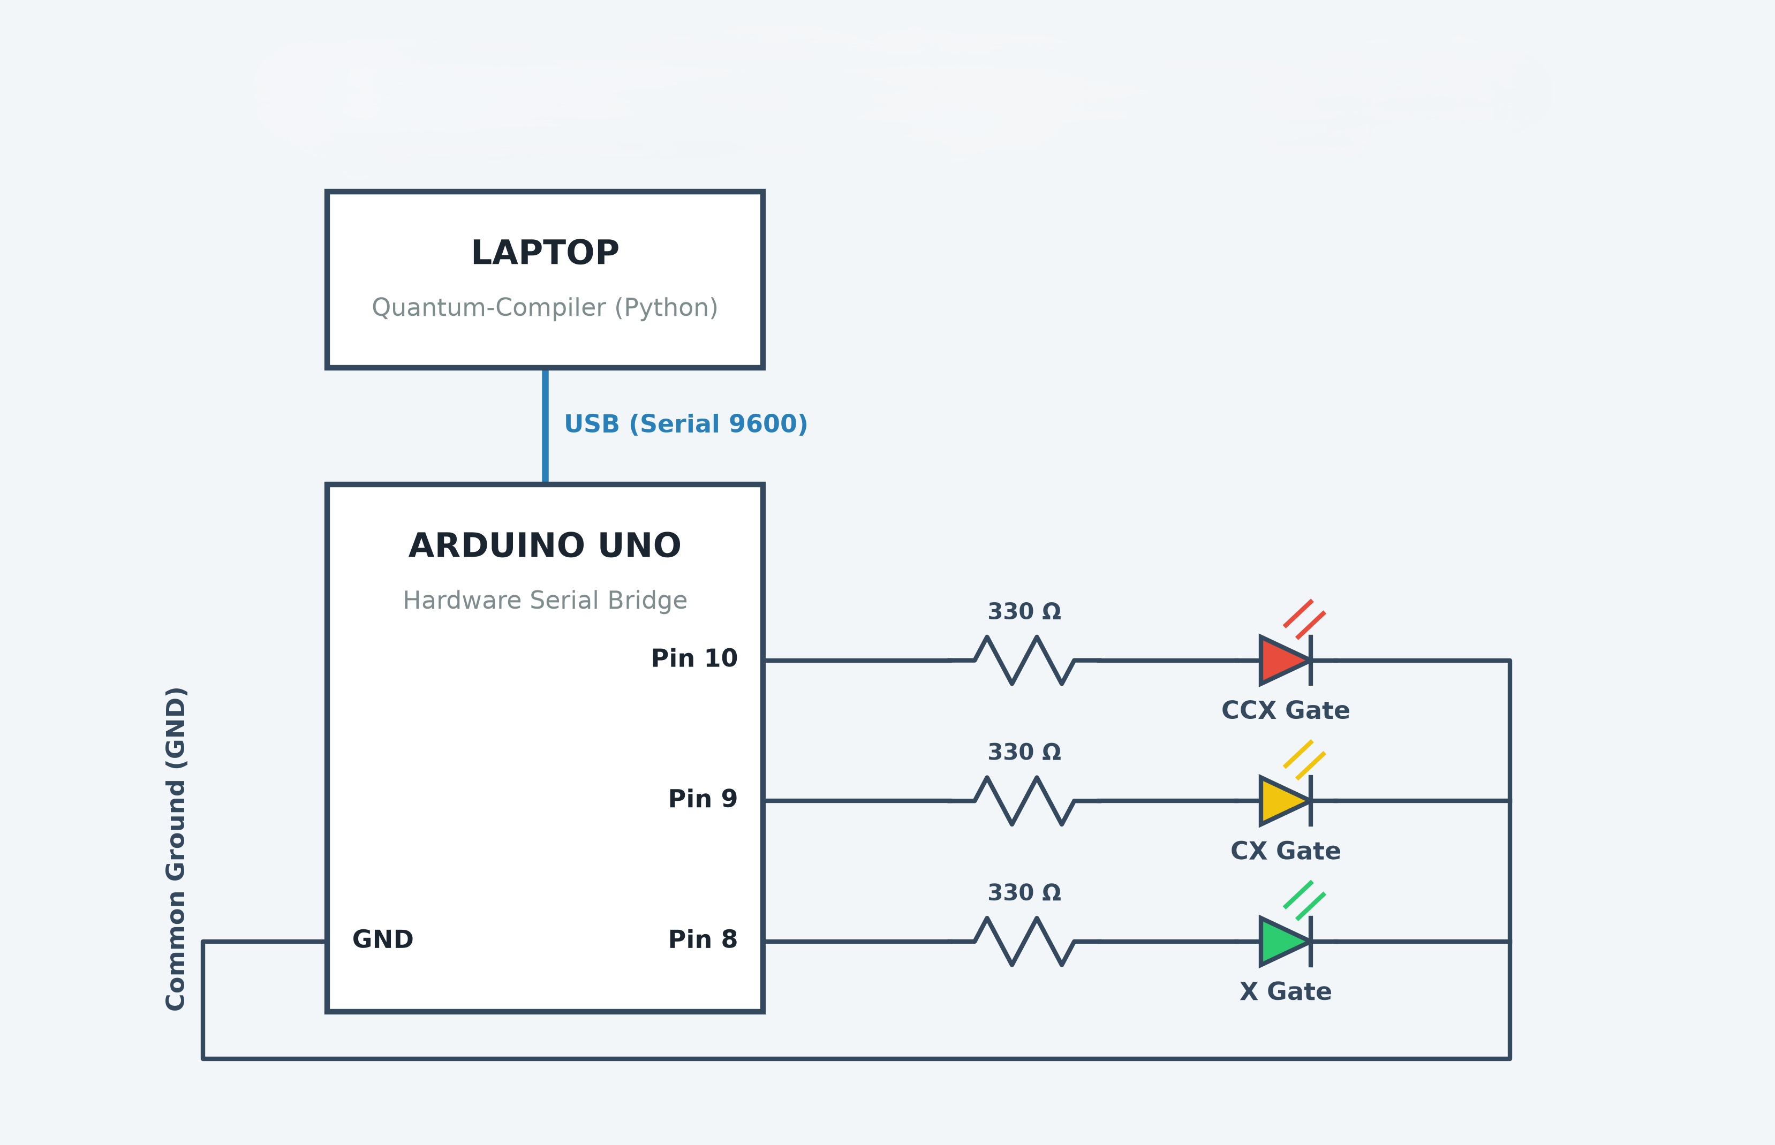
Results:
The Pulse Simulation Circuit Implementation
Python transpiler connects directly to the Arduino via USB.
Logical quantum gates trigger distinct physical GPIO pulses.
LED durations physically simulate real-time hardware execution costs.
Provides tangible proof of the algorithmic time savings.
Figure 8: Schematic of the hardware serial bridge mapping quantum transpiler operations to physical microcontroller pulses.

Slide 10
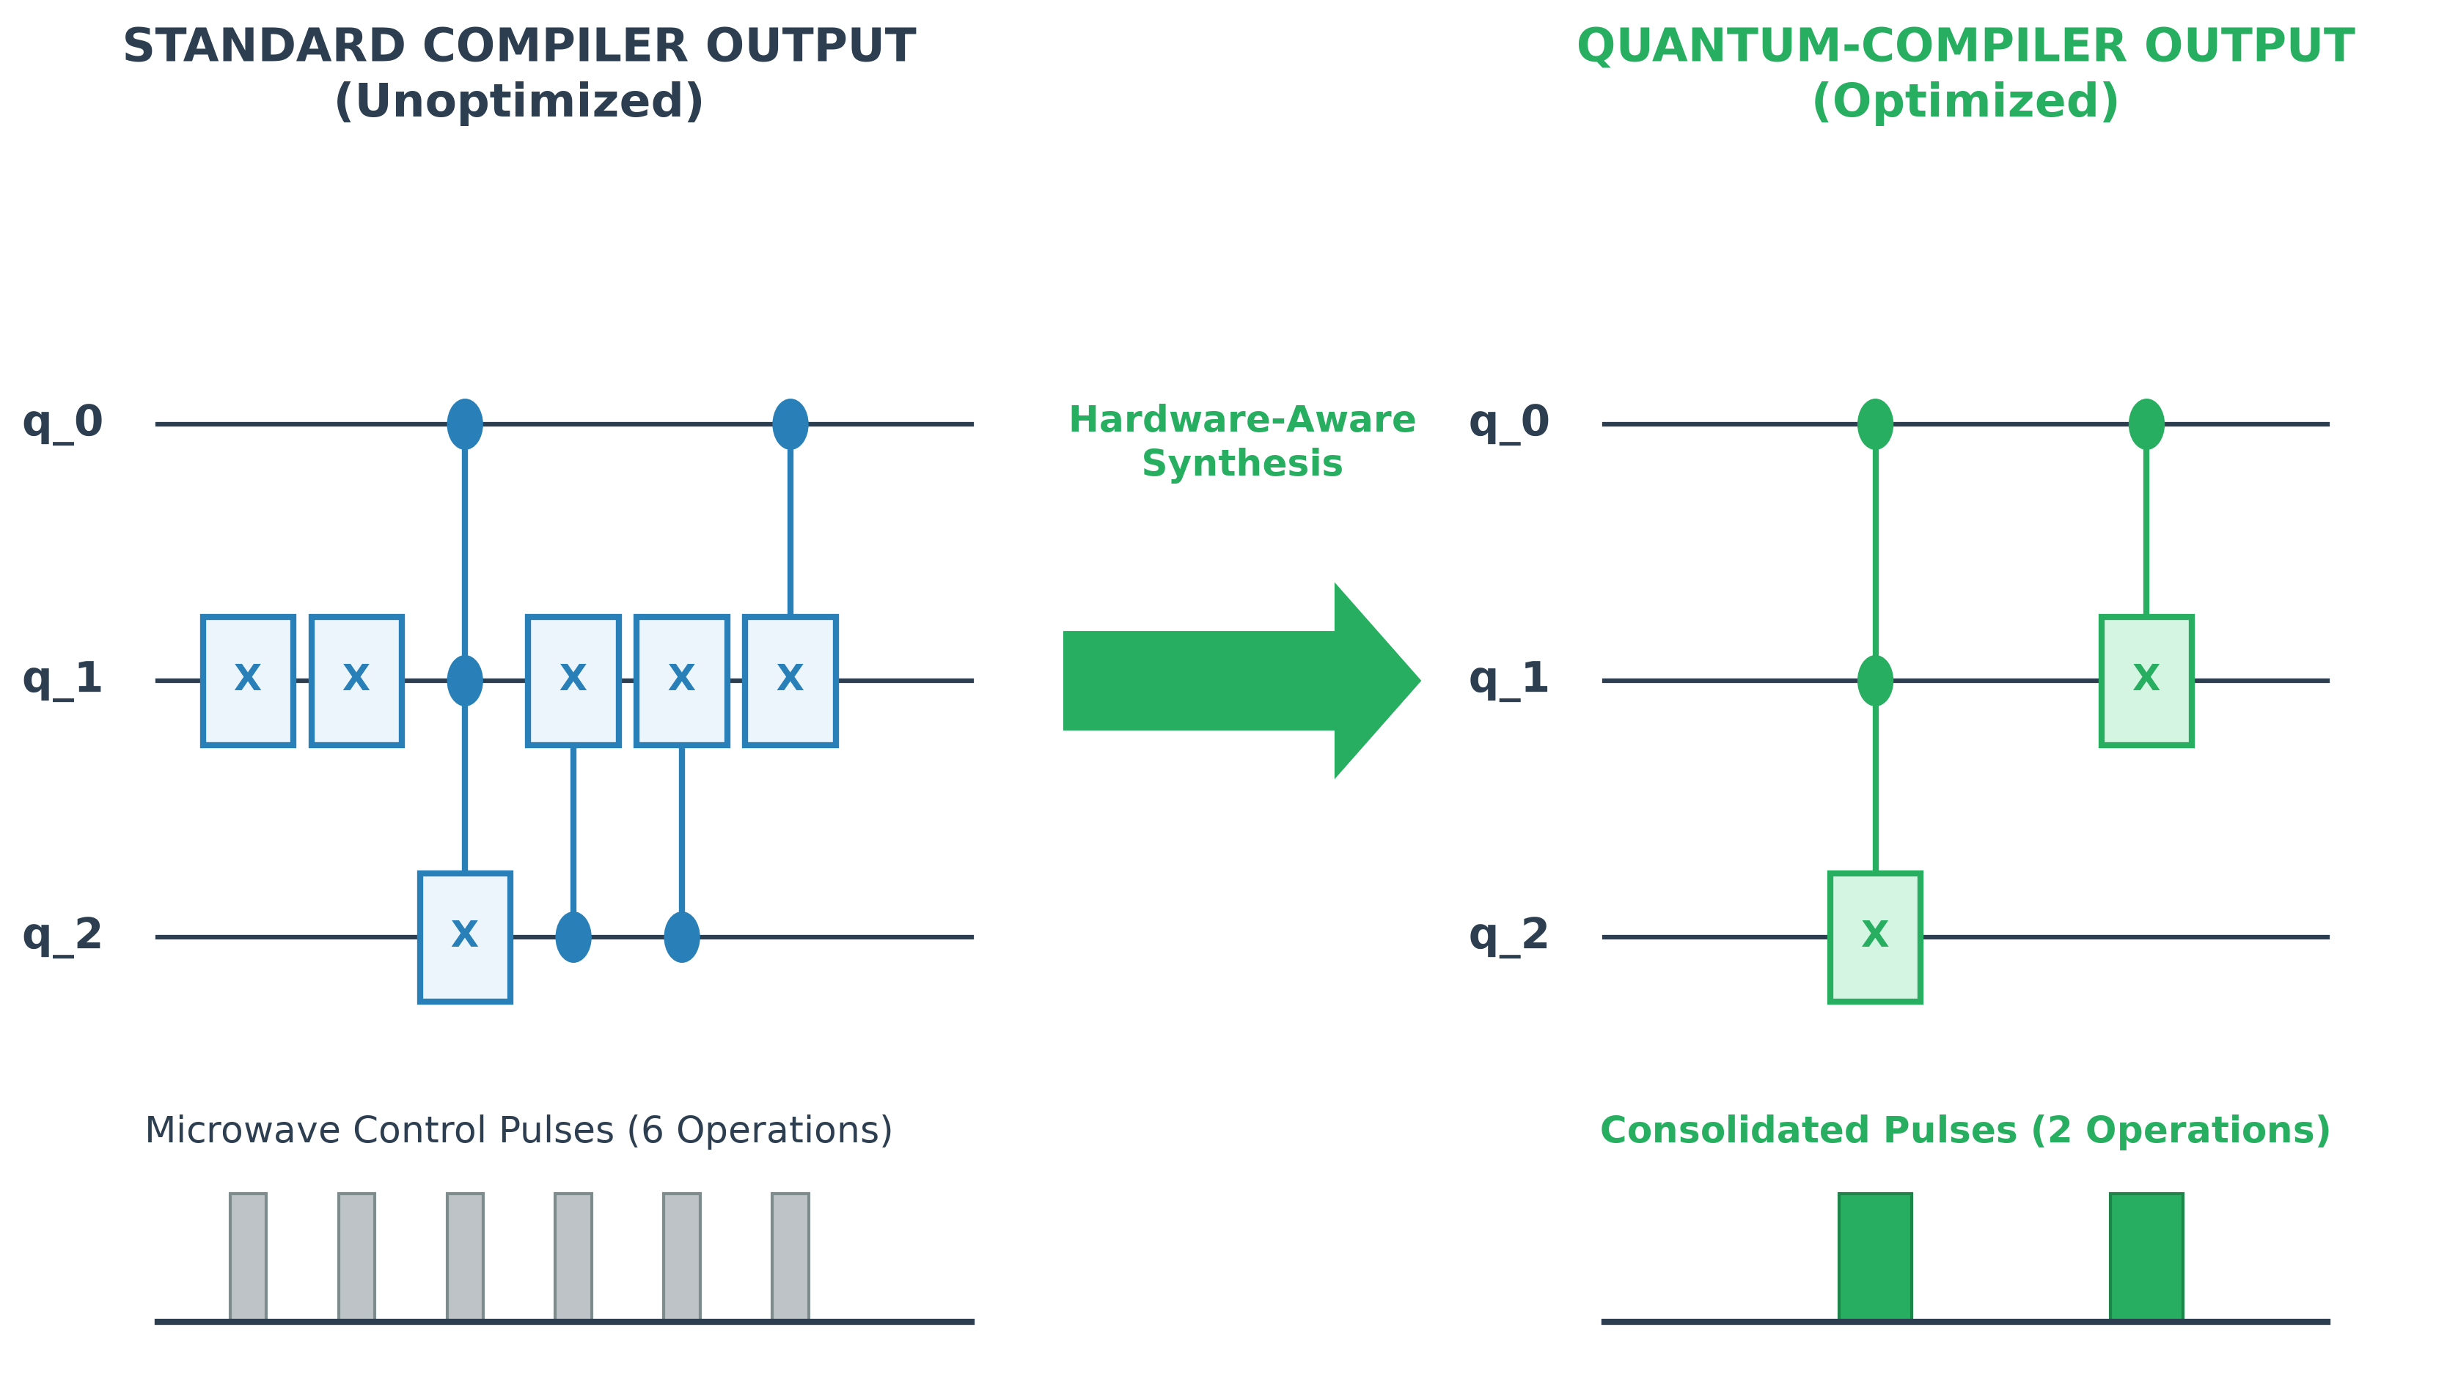
Hardware Validation on IBM Quantum
Proven Real-World Impact
Theoretical optimizations must translate to physical hardware gains.
Wall-clock execution time cut from 8.31 s to 6.06 s.
This drastically minimizes costly, error-prone pulse operations on the superconducting transmon qubits.
Figure 9: Physical hardware validation demonstrating the consolidation of microwave control pulses.

Slide 11
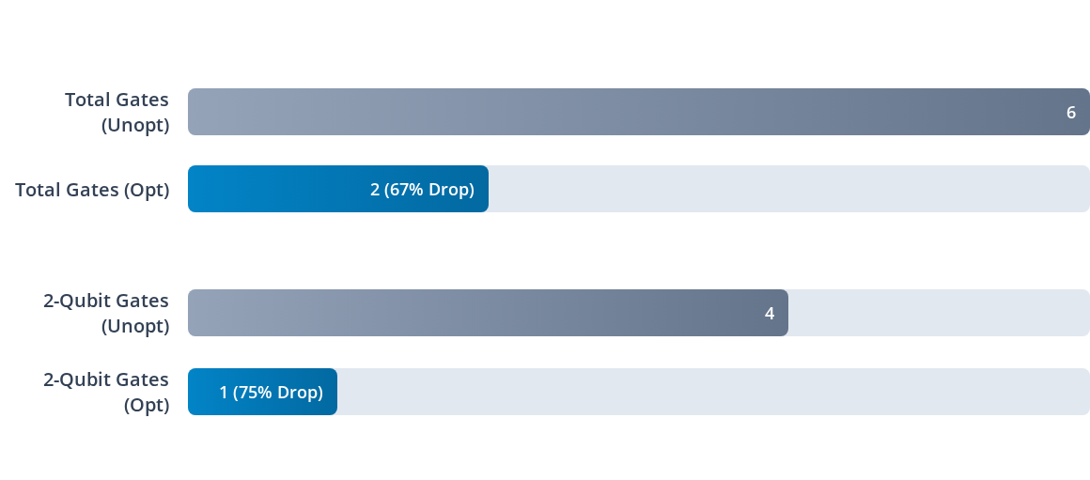
Evaluation: The NAND Benchmark
Quantitative circuit-level reductions demonstrating transpiler efficiency.
Figure 10: Quantitative logic gate reduction metrics achieved on the standard NAND benchmark circuit.

Slide 12
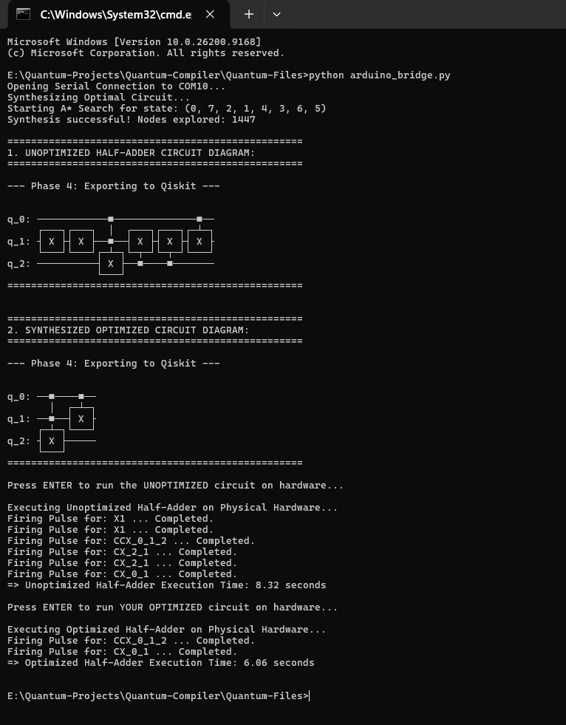
Results from the Terminal:
Successfully exports the synthesized logic into Qiskit ASCII diagrams for clear visual verification.
Baseline execution of the unoptimized 6-gate sequence takes 8.32 seconds on physical hardware.
Optimized execution of the collapsed 2-gate sequence reduces total runtime down to 6.06 seconds.
Figure 11: Terminal output demonstrating Qiskit export and physical hardware execution time reduction.

Slide 13
Conclusion:
Automates the translation of logical Boolean circuits into optimized, hardware-aware quantum circuits.
The three-pass pipeline effectively targets and eliminates localized logical redundancies.
Achieved a 67% gate reduction and a 27% faster execution time on IBM Quantum hardware.
Future steps include expanding the rewrite library and adding routing-aware cost models to the exact search.

Slide 14
Questions?
Quantum-Compiler successfully bridges high-level logic and hardware constraints using a multi-pass architecture.
Thank you for your time.
Be in touch with Avinash
: thotaavinash8795@gmail.com
: https://github.com/ThotaAvinash07-87

